Slide 1
Information Security Essentials
Week 11 Lecture 21
29-11-2023
Presented by: Sir Yawar Abbas

Slide 2
Mobile Device Security
Obtained from: web.cse.ohio-state.edu › courses › 4471_mobile_device_security_handout

Slide 3
Organization
Quick Overview of Mobile Devices
Mobile Threats and Attacks
Countermeasures
TaintDroid/Taint Tracking

Slide 4
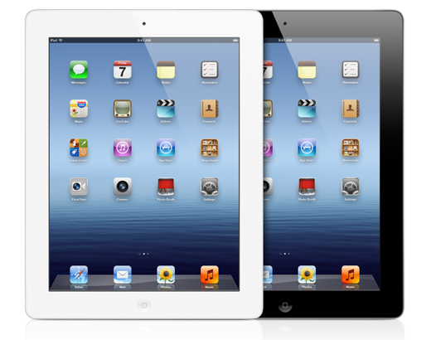

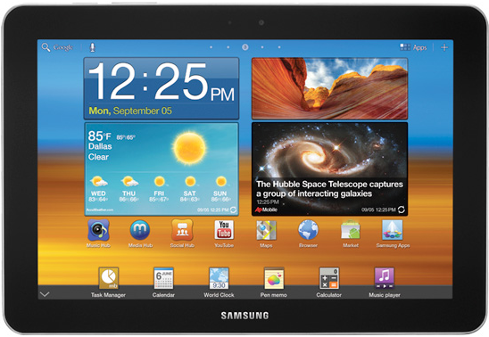
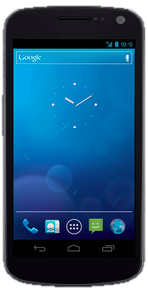
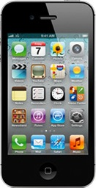
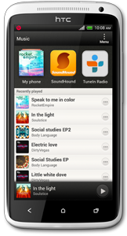








Overview of Mobile Devices
Mobile computers:
Mainly smartphones, tablets
Sensors: GPS, camera, accelerometer, etc.
Computation: powerful CPUs (≥ 1 GHz, multi-core)
Communication: cellular/4G, Wi-Fi, near field communication (NFC), etc.
Many connect to cellular networks: billing system
Cisco: 7 billion mobile devices will have been sold by 2012 [1]
Organization

Slide 5
Organization
Quick Overview of Mobile Devices
Mobile Threats and Attacks
Countermeasures

Slide 6
Mobile Threats and Attacks
Mobile devices make attractive targets:
People store much personal info on them: email, calendars, contacts, pictures, etc.
Sensitive organizational info too…
Can fit in pockets, easily lost/stolen
Built-in billing system: SMS/MMS (mobile operator), in-app purchases (credit card), etc.
Many new devices have near field communications (NFC), used for contactless payments, etc.
Your device becomes your credit card
Location privacy issues
NFC-based billing system vulnerabilities

Slide 7
Mobile Device Loss/Theft
Many mobile devices lost, stolen each year
113 mobile phones lost/stolen every minute in the U.S. [15]
56% of us misplace our mobile phone or laptop each month [15]
Lookout Security found $2.5 billion worth of phones in 2011 via its Android app [16]
Symantec placed 50 “lost” smartphones throughout U.S. cities [17]
96% were accessed by finders
80% of finders tried to access “sensitive” data on phone

Slide 8
Device Malware
iOS malware: very little
Juniper Networks: Major increase in Android malware from 2010 to 2011 [18]
Android malware growth keeps increasing ($$$)
Main categories: [19]
Trojans
Monitoring apps/spyware
Adware
Botnets
We’ll look at notable malware examples

Slide 9
Device Search and Seizure
People v. Diaz: if you’re arrested, police can search your mobile device without warrant [26]
Rationale: prevent perpetrators destroying evidence
Quite easy to break the law (overcriminalization) [27]
Crime severity: murder, treason, etc. vs. unpaid citations
“Tens of thousands” of offenses on the books [26]
Easy for law enforcement to extract data from mobile devices (forensics) [28]

Slide 10
Location Disclosure
MAC, Bluetooth Addresses, IMEI, IMSI etc. are globally unique
Infrastructure based mobile communication
Peer-t-Peer ad hoc mobile communication

Slide 11
Organization
Quick Overview of Mobile Devices
Mobile Threats and Attacks
Countermeasures

Slide 12
Mobile Access Control
Very easy for attacker to control a mobile device if he/she has physical access
Especially if there’s no way to authenticate user
Then device can join botnet, send SMS spam, etc.
Need access controls for mobile devices
Authentication, authorization, accountability
Authentication workflow:
Request access
Supplication (user provides identity, e.g., John Smith)
Authentication (system determines user is John)
Authorization (system determines what John can/cannot do)

Slide 13
Authentication: Categories
Authentication generally based on:
Something supplicant knows
Password/passphrase
Unlock pattern
Something supplicant has
Magnetic key card
Smart card
Token device
Something supplicant is
Fingerprint
Retina scan

Slide 14
Authentication: Passwords
Cheapest, easiest form of authentication
Works well with most applications
Also the weakest form of access control
Lazy users’ passwords: 1234, password, letmein, etc.
Can be defeated using dictionary, brute force attacks
Requires administrative controls to be effective
Minimum length/complexity
Password aging
Limit failed attempts

Slide 15
Authentication: Smart Cards/ Security Tokens
More expensive, harder to implement
Vulnerability: prone to loss or theft
Very strong when combined with another form of authentication, e.g., a password
Does not work well in all applications
Try carrying a smart card in addition to a mobile device!

Slide 16
Authentication: Biometrics
More expensive/harder to implement
Prone to error:
False negatives: not authenticate authorized user
False positives: authenticate unauthorized user
Strong authentication when it works
Does not work well in all applications
Fingerprint readers becoming more common on mobile devices (Atrix 4G)

Slide 17
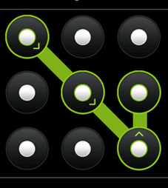
Authentication: Pattern Lock
Swipe path of length 4–9 on 3 x 3 grid
Easy to use, suitable for mobile devices
Problems: [30]
389,112 possible patterns; (456,976 possible patterns for 4-char case-insensitive alphabetic password!)
Attacker can see pattern from finger oils on screen

Slide 18
Authentication: Comparison
 | Passwords | Smart Cards | Biometrics | Pattern Lock
Security | Weak | Strong | Strong | Weak
Ease of Use | Easy | Medium | Hard | Easy
Implementation | Easy | Hard | Hard | Easy
Works for phones | Yes | No | Possible | Yes
– Deeper problem: mobile devices are designed with single-user
assumption…

Slide 19
DiffUser (1)
Current smartphone access control focus: 1 user (admin)
Hard to achieve fine-grained mobile device management:
Control app installation/gaming
Parental controls
Lend phone to friend
We design DiffUser, differentiated user access control model [31]
Different users use smartphone in different contexts
User classification: admin, “normal,” guest
Smartphone Privileges |  | Admin | Normal | Guest
Personal Info | SMS | ✔ | ✔ | ✘
 | Contacts | ✔ | ✔ | ✘
Resource Access | WiFi | ✔ | ✔ | Limit‼
 | GPS | ✔ | ✔ | Limit‼
 | Bluetooth | ✔ | ✔ | Limit‼
Apps | App Install | ✔ | Limit | ✘
 | Sensitive Apps | ✔ | Limit | ✘
Source: [31], Table 1.

Slide 20
DiffUser (2)
Implement our system on Android using Java
Override Android’s “Home” Activity for multi-user authentication, profile configuration
Source: [31], Figure 2. From left to right: “normal” user screen;
user login and authentication; user profile configuration.

Slide 21
Mobile Device Information Leakage
Types of mobile device information sources:
Internal to device (e.g., GPS location, IMEI, etc.)
External sources (e.g., CNN, Chase Bank, etc.)
Third-party mobile apps can leak info to external sources [32]
Send out device ID (IMEI/EID), contacts, location, etc.
Apps ask permission to access such info; users can ignore!
Apps can intercept info sent to a source, send to different destination!
Motives:
Monitor employees’ activity using accelerometers (cited in [32])
Ads, market research (include user location, behavior, etc.)
Malice
How do we protect against such information leakage?

Slide 22
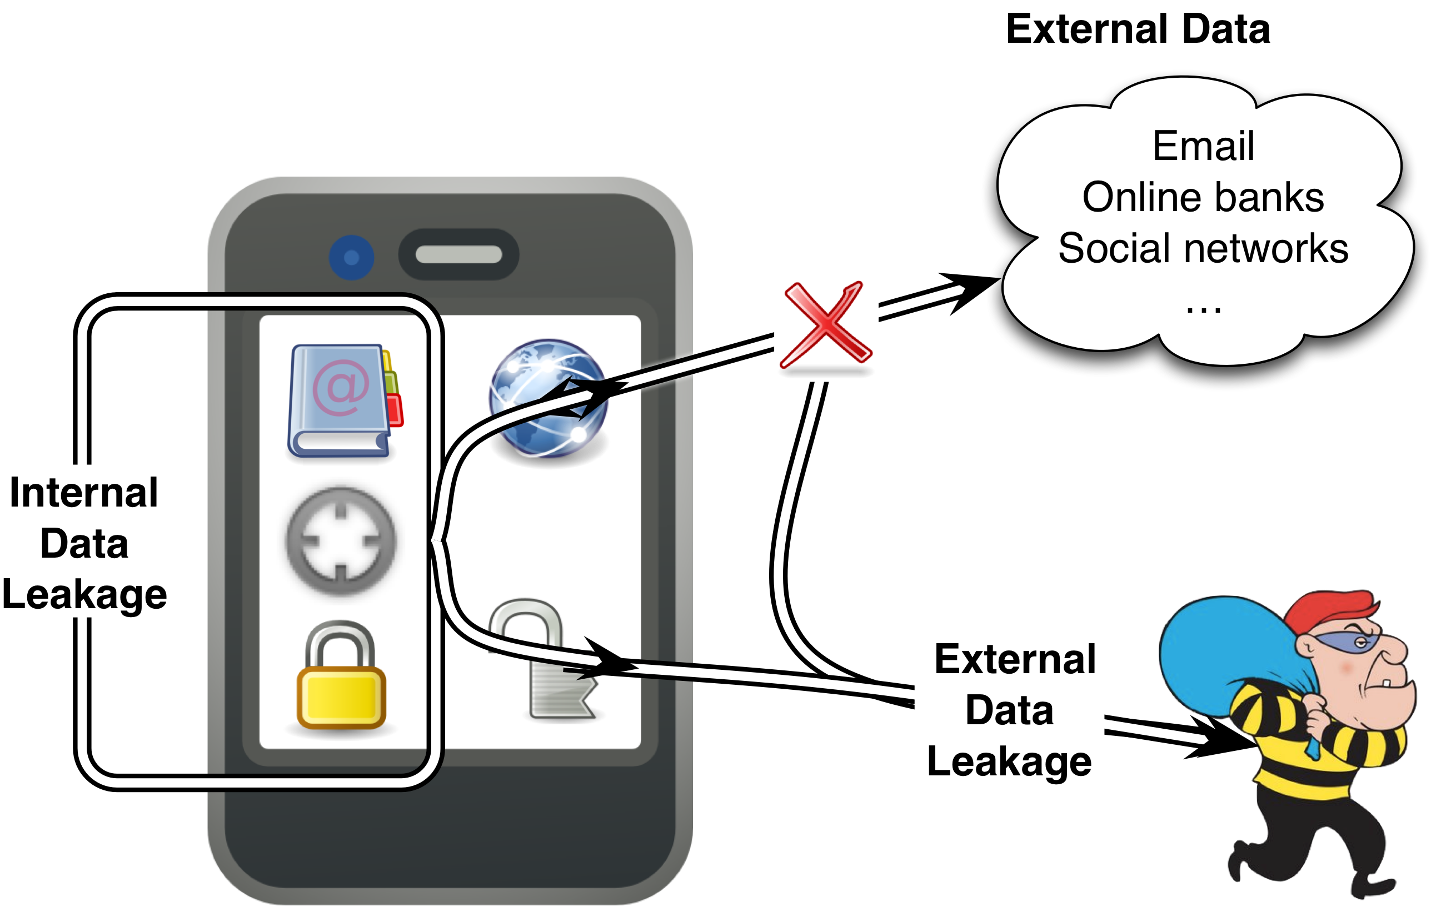
Information Flow Tracking (IFT)
IFT tracks each information flow among internal, external sources
Each flow is tagged, e.g., “untrusted”
Tag propagated as information flows among internal, external sources
Sound alarm if data sent to third party
Challenges
Reasonable runtime, space overhead
Many information sources
“trusted”
“untrusted”
Information leakage on mobile devices

Slide 23
TaintDroid
Enck et al., OSDI 2010 [32]
IFT system on Android 2.1
System firmware (not app)
Modifies Android’s Dalvik VM, tracks info flows across methods, classes, files
Tracks the following info:
Sensors: GPS, camera, accelerometer, microphone
Internal info: contacts, phone #, IMEI, IMSI, Google acct
External info: network, SMS
Notifies user of info leakage
Source: [33]
*The Dalvik Virtual Machine (DVM) is an android virtual machine optimized for mobile devices. It optimizes the virtual machine for memory, battery life and performance.
TaintDroid is used for Tracking using DVM

Slide 24
Location Privacy Protection
Strong regulation
Corporate
Individual
Dynamic MAC and Bluetooth addresses?
Collision
How often to change?
Proxy-based communications
Dummy device as proxy
Group communications

Slide 25
Summary
Mobile devices are increasingly popular
There are many threats and attacks against mobile devices, e.g., loss/theft, sensitive information leakage, and location privacy compromise
Mobile access control, information leakage protection, and location privacy protection, etc.

Slide 26
Conclusions and summary

Slide 27
References (1)
Cisco, “Cisco Visual Networking Index: Global Mobile Data Traffic Forecast Update, 2011–2016”, 14 Feb. 2012, http://www.cisco.com/en/US/solutions/collateral/ns341/ns525/ns537/ ns705/ns827/white_paper_c11-520862.html
Samsung, “Exynos 5 Dual,” 2012, http://www.samsung.com/global/business/semiconductor/ product/application/detail?productId=7668&iaId=2341
Nielsen Co., “Two Thirds of All New Mobile Buyers Now Opting for Smartphones,” 12 Jul. 2012, http://blog.nielsen.com/nielsenwire/online_mobile/two-thirds-of-new-mobile-buyers- now-opting-for-smartphones/
K. De Vere, “iOS leapfrogs Android with 410 million devices sold and 650,000 apps,” 24 Jul. 2012, http://www.insidemobileapps.com/2012/07/24/ios-device-sales-leapfrog-android-with- 410-million-devices-sold/
K. Haslem, “Macworld Expo: Optimised OS X sits on ‘versatile’ Flash,” 12 Jan. 2007, Macworld, http://www.macworld.co.uk/ipod-itunes/news/index.cfm?newsid=16927
Wikipedia, “iOS,” updated 2012, http://en.wikipedia.org/wiki/iOS
Apple Inc., “iPhone Developer University Program,” http://developer.apple.com/iphone/program/university.html
Apple Inc, “iOS Security,” http://images.apple.com/ipad/business/docs/ iOS_Security_May12.pdf
Android Open Source Project, “Android Security Overview,” http://source.android.com/tech/ security/index.html
Presentation organization inspired by T. Eston, “Android vs. iOS Security Showdown,” 2012,
http://www.slideshare.net/agent0x0/the-android-vs-apple-ios-security-showdown

Slide 28
References (2)
A. Rubin, 15 Feb. 2012, https://plus.google.com/u/0/112599748506977857728/ posts/Btey7rJBaLF
H. Lockheimer, “Android and Security,” 2 Feb. 2012, http://googlemobile.blogspot.com/ 2012/02/android-and-security.html
Android Open Source Project, http://developer.android.com/about/dashboards/index.html
M. DeGusta, “Android Orphans: Visualizing a Sad History of Support,” 26 Oct. 2011, http://theunderstatement.com/post/11982112928/android-orphans-visualizing-a-sad-history-of-support
http://opensignalmaps.com/reports/fragmentation.php
http://www.micro-trax.com/statistics `
Lookout, Inc., “Mobile Lost and Found,” 2012, https://www.mylookout.com/resources/ reports/mobile-lost-and-found/
K. Haley, “Introducing the Smartphone Honey Stick Project,” 9 Mar. 2012, http://www.symantec.com/connect/blogs/introducing-symantec-smartphone-honey-stick-project
Juniper Networks, Inc., “Global Research Shows Mobile Malware Accelerating,” 15 Feb. 2012, http://newsroom.juniper.net/press-releases/global-research-shows- mobile-malware-accelerating-nyse-jnpr-0851976

Slide 29
References (3)
F-Secure, “Mobile Threat Report Q2 2012,” 7 Aug. 2012, http://www.slideshare.net/fsecure/ mobile-threat-report-q2-2012
http://nakedsecurity.sophos.com/2012/04/12/a ndroid-malware-angry-birds-space-game/
Via Forensics LLC, “Forensic Security Analysis of Google Wallet,” 12 Dec. 2011, https://viaforensics.com/mobile-security/forensics-security-analysis-google-wallet.html
Proxmark, http://www.proxmark.org/
libnfc, http://www.libnfc.org
D. Goodin, “Android, Nokia smartphone security toppled by Near Field Communication hack,” 25 Jul. 2012, http://arstechnica.com/security/2012/07/android-nokia-smartphone-hack/
B. Andersen, “Australian admits creating first iPhone virus,” 10 Nov. 2009, http://www.abc.net.au/news/2009-11-09/australian-admits-creating-first-iphone-virus/1135474
R. Radia, “Why you should always encrypt your smartphone,” 16 Jan. 2011, http://arstechnica.com/gadgets/2011/01/why-you-should-always-encrypt-your-smartphone/
Heritage Foundation, “Solutions for America: Overcriminalization,” 17 Aug. 2010, http://www.heritage.org/research/reports/2010/08/overcriminalization
Wikipedia, http://en.wikipedia.org/wiki/Mobile_device_forensics
C. Quentin, http://www.slideshare.net/cooperq/your-cell-phone-is-covered-in-spiders

Slide 30
References (4)
A. J. Aviv, K. Gibson, E. Mossop, M. Blaze, and A. M. Smith, “Smudge Attacks on Smartphone Touch Screens,” Proc. USENIX WOOT, 2010.
X. Ni, Z. Yang, X. Bai, A. C. Champion, and Dong Xuan, “DiffUser: Differentiated User Access Control on Smartphones,” Proc. IEEE Int’l. Workshop on Wireless and Sensor Networks Security (WSNS), 2009.
W. Enck, P. Gilbert, B.-G. Chun, L. P. Cox, J. Jung, P. McDaniel, and A. N. Sheth, “TaintDroid: An Information-Flow Tracking System for Realtime Privacy Monitoring on Smartphones,” Proc. USENIX OSDI, 2010, http://appanalysis.org
W. Enck, P. Gilbert, B.-G. Chun, L. P. Cox, J. Jung, P. McDaniel, and A. N. Sheth, “TaintDroid: An Information-Flow Tracking System for Realtime Privacy Monitoring on Smartphones,” http://static.usenix.org/event/osdi10/tech/slides/enck.pdf
B. Gu, X. Li, G. Li, A. C. Champion, Z. Chen, F. Qin, and D. Xuan, “D2Taint: Differentiated and Dynamic Information Flow Tracking on Smartphones for Numerous Data Sources,” Technical Report, 2012.

Slide 31
The End

